Slide 1
EDA ANALYSIS: (binary and closed response)

Slide 2
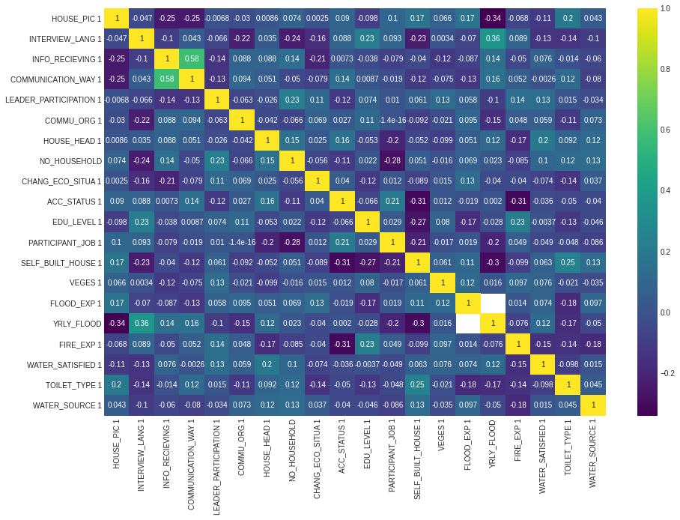
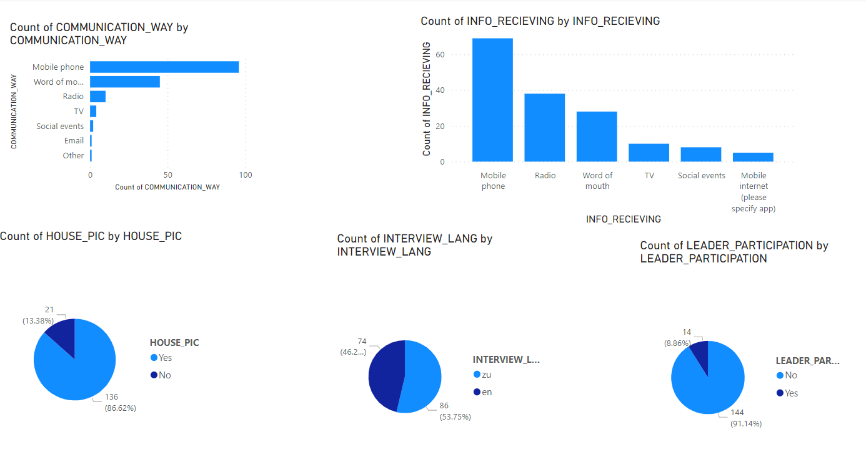
CORRELATION OF closed ended response
There is a positive relationship between communication way and information receiving
There was no strong relationship between answers

Slide 3
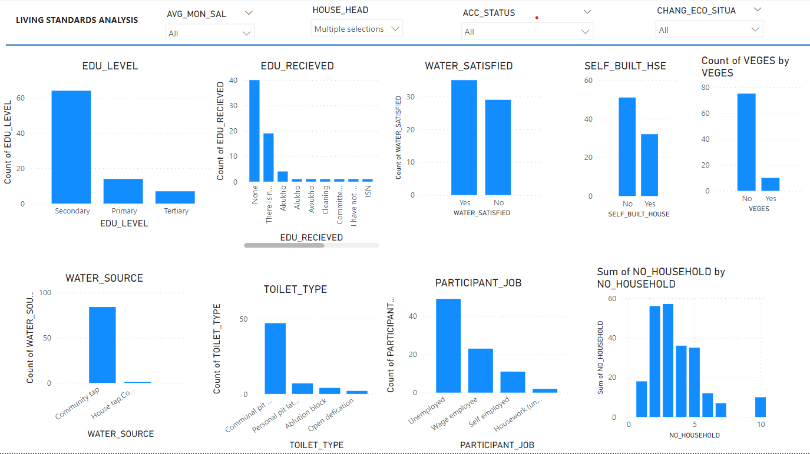
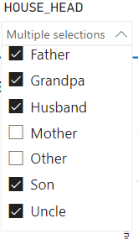
DASHBOARD OF MALE HEADED HOUSEHOLD IN TERMS OF LIVING STANDARDS
Male headed household consist of

Slide 4
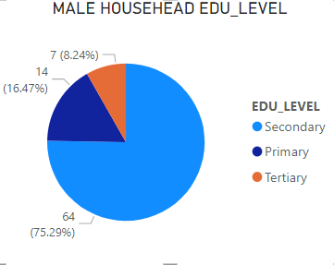
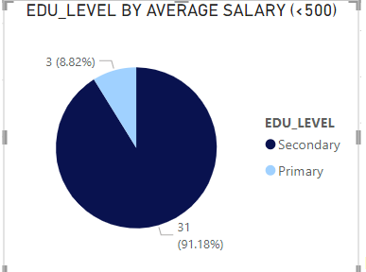
Male-headed household Comparisons
Educational levels
The total number of households with men as the head was 85 of 159 (complete answered questionnaire), which is 53.46%
None of the male-headed households was without education. Most had secondary education with about 75%
Salary ranged from below 500 to 3500 among male-headed houses
The educational levels of people didn’t have a relation to salaries as 91% of the people who earned below 500 had secondary education and a few with primary education.
All who earned above 3000 had secondary education
Tertiary-educated people in the male-headed household had an average monthly salary of 2000 or 2500

Slide 5
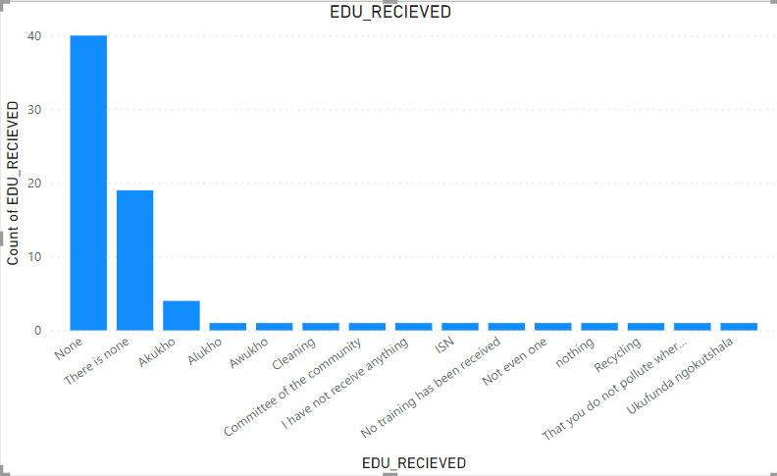
Male-headed household (Social Education received )
What training have you received, if any, from the municipality or other organizations active in the community?
The majority of them had not received any social education.
This is seen in the responses such as
None - 40
There is none - 19
I have not received anything - 1
No training has been received - 1
Not even one - 1
Nothing – 1
In total 74% have had none

Slide 6
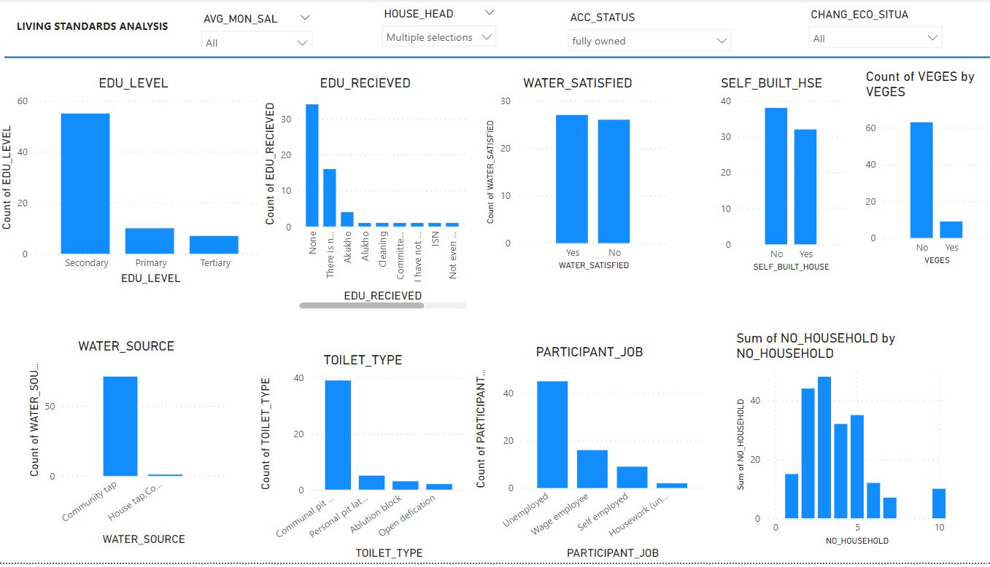
Dashboard of fully owned male-headed households
85 people in male headed houses responded to their accommodation status.
Out of this 72 were fully owned and 13 were rented
Fully owned
Most of these houses were self built houses (54.29%)
Majority of fully owned households didn’t have latrine in the house. Hence 79.59% used community taps
Even though these houses were fully owned majority didn’t have vegetation farm in them.(87.5%)
They were sightly indifferent about their water satisfaction as 98% didn’t have taps in house and used community tap
The participant of the houses were mostly unemployed.(62.5%)

Slide 7
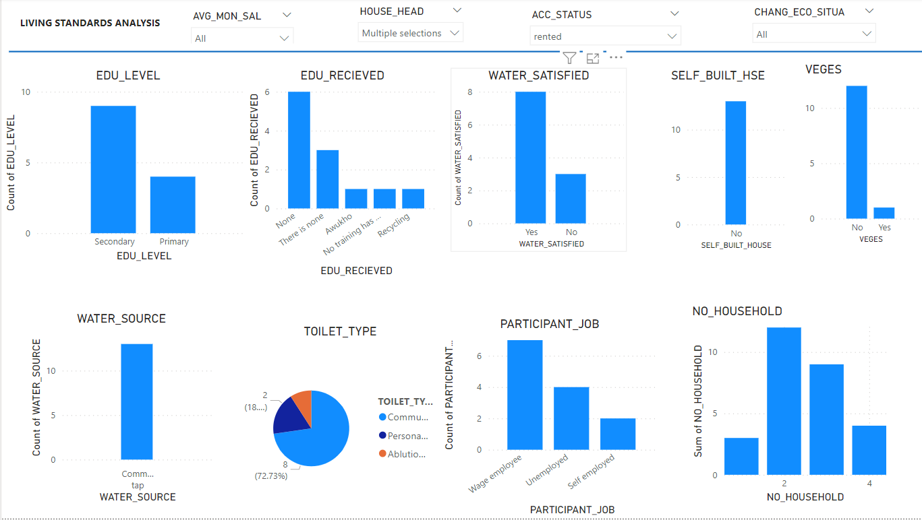
Dashboard of rented male-headed households
Rental
Average salary ranged from <500 and 2500
All rental accommodation used community taps
72% didn’t have personal latrine so used community’s
Majority of them had it participant as wage employees
They had a number of household below 4

Slide 8
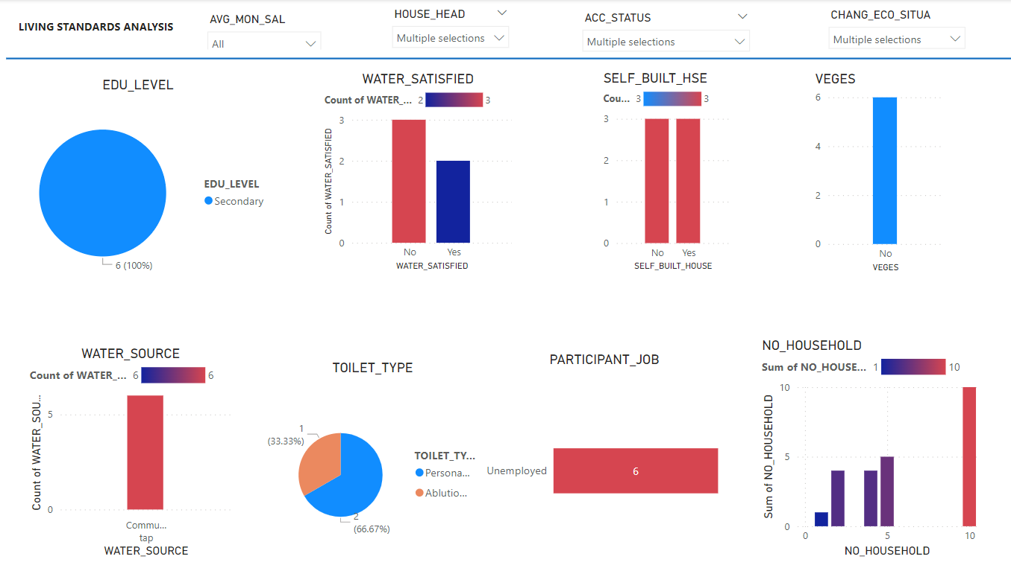
Change in economic situation in male headed houses : Became worst & a lot worst
Those who had their economic situation becoming worst or a lot worst were 7% of total male headed houses.
This people had participant unemployed.
Majority of this household number was 10
They all had an average salary below 500
They were not happy with water source

Slide 9
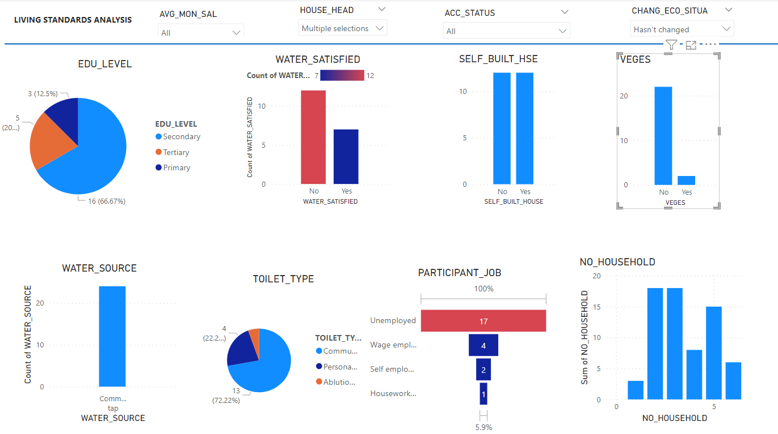
Change in economic situation in male headed houses : No change in economic situation
Dividing those whose economic situation hasn’t changed into a salary range of 1500 and below, and 2000 and above
1500 and below
75% of the people with tertiary and their salary was 500 on average
They were indifferent about their water source being a community tap
Household participants were mostly unemployed
The number of households ranged from 1-5
2000 and above
Had all unsatisfied with a water source
80% of them used communal pit
All had some form of education

Slide 10
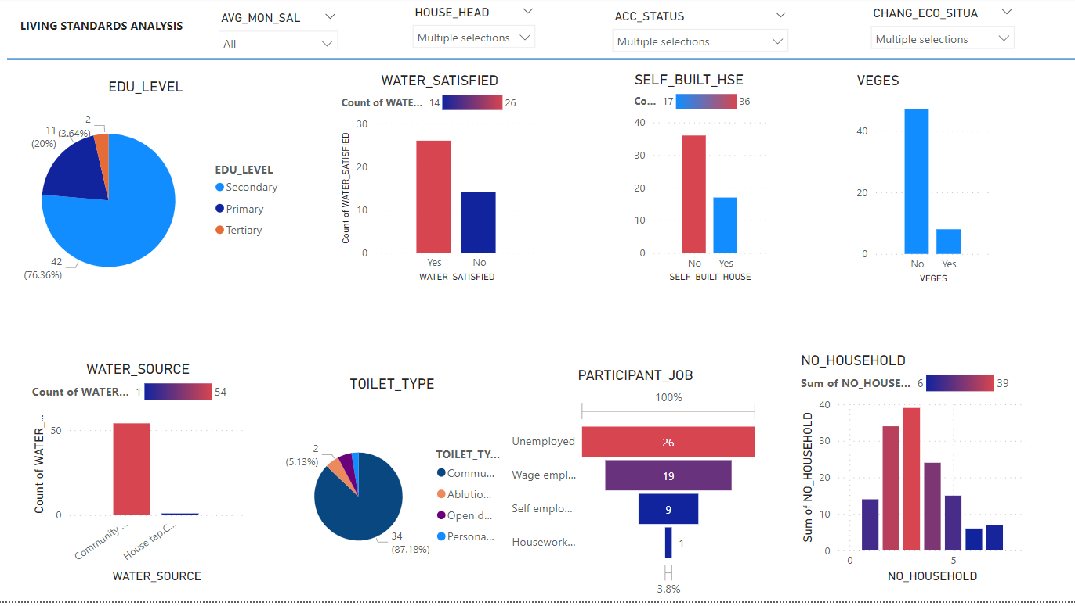
Change in the economic situation in male-headed houses: Improved a lot & Improved a bit
The majority were satisfied with their water source
The salary range for improved a lot was from 500-1500 with it participants mostly wage employed
The salary for improved bit cut across >500-3500 With the majority of it house members unemployed.
Both had 3 as the dominant number of household

Slide 11
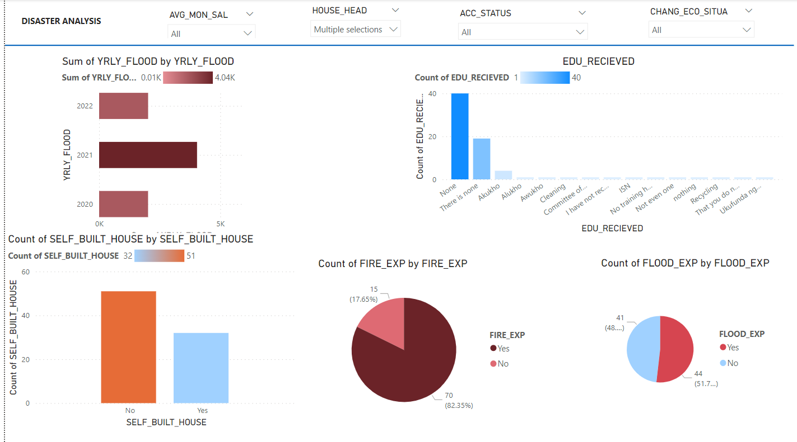
Disaster Analysis: Male Headed household
For male-headed houses the maximum number of floods occurred in 2021
82% had experienced fire
51.76% had experienced flood
But a majority didn’t build themselves?
Possibly this could be due to the fact that the majority was hadn’t received social education
Even those with a lot of life improvement experienced fire and flood in 2020 or 2021
On the other hand those who had the worst economic situation had 100% of fire experience and 83% of flood experience in 2022
Those who rented had less fire and flood experience

Slide 12
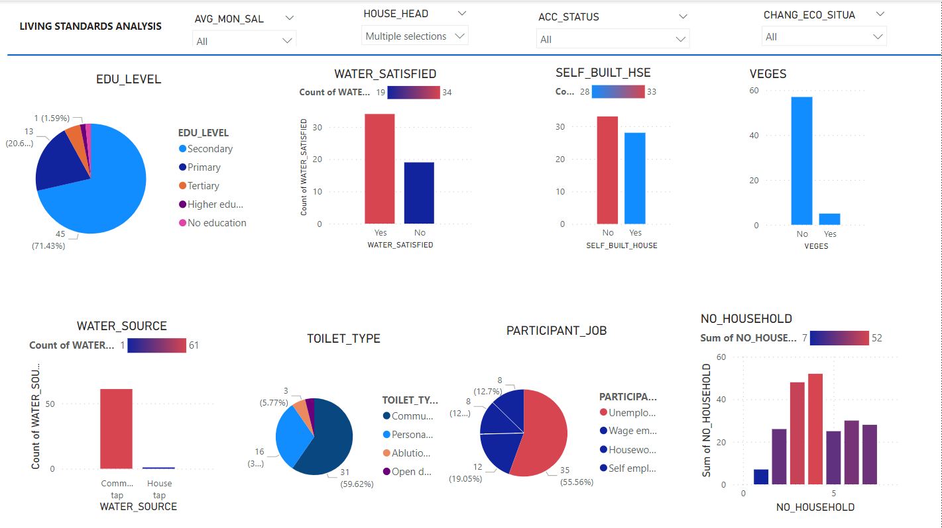
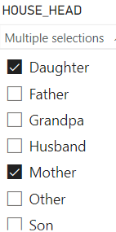
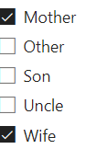
DASHBOARD OF FEMALE HEADED HOUSEHOLD IN TERMS OF LIVING STANDARDS
Female-headed household consist of

Slide 13
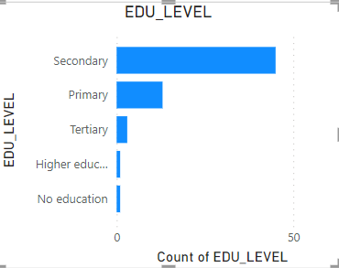
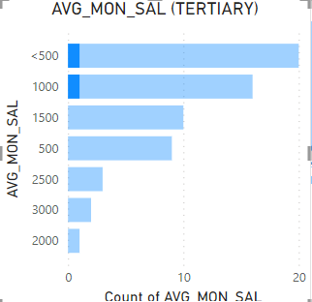
Female-headed household Comparisons
Educational levels
The total number of households with female as the head was 63 of 159 (complete answered questionnaire), which is the 40%
Less than 2% was without education. Most had secondary education with about 75%
Salary ranged from below 500 to 3000 among female-headed houses
The educational levels of people didn’t have a relation to salaries like in the men headed as tertiary’s average salary was 1000 and below.
All who earned above 3000 had secondary education like men headed

Slide 14
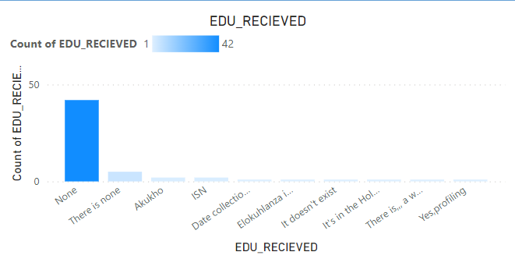
Female-headed household (Social Education received )
What training have you received, if any, from the municipality or other organizations active in the community?
Most of them had not received any social education like male-headed
This is seen in the responses such as
None - 42
There is none - 5
It doesn’t exist - 1
In total 75% had none
In comparison Man headed had 74% none

Slide 15
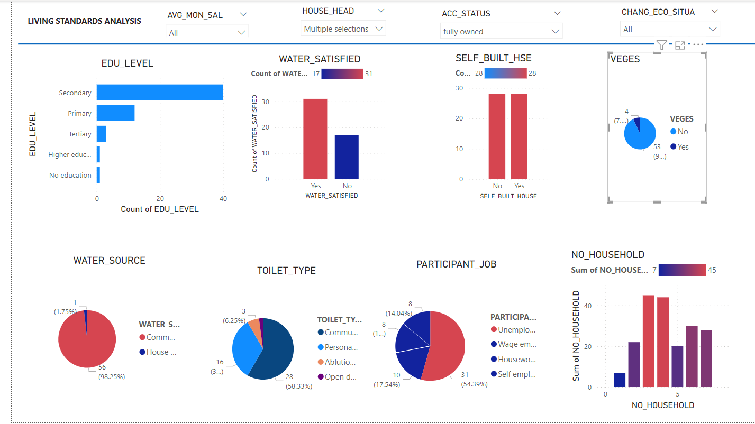
Dashboard of fully owned female-headed households
85 people in male headed houses responded to their accommodation status.
Out of this 72 were fully owned and 13 were rented
Fully owned
These houses had equal amount of self buit to not self built
As in men-headed fully owned houses didn’t have latrine in the house but this was a pit less in this case with 58%. They had higher rate on personal toilet type with 33% compared to 10%
98% used community taps and were satisfied with that
Even though these houses were fully owned majority didn’t have vegetation farm in them.(92%)
The participant of the houses were mostly unemployed.(54%)
Household number ranged from 1 to 7,with most either 3 or 4

Slide 16
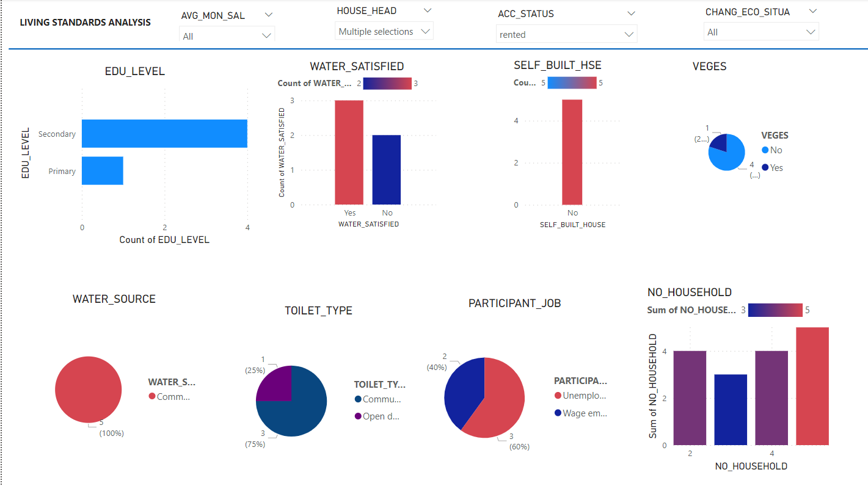
Dashboard of rented female-headed households
Rental
Average salary ranged from <500 and 2500 same as men
All rental accommodation used community taps (100%)
None had personal latrine so used community’s(75%) or Open defication (25%)
It participant where either wage employees(40%) or unemployed (60%)
The dominant number of household was 5

Slide 17
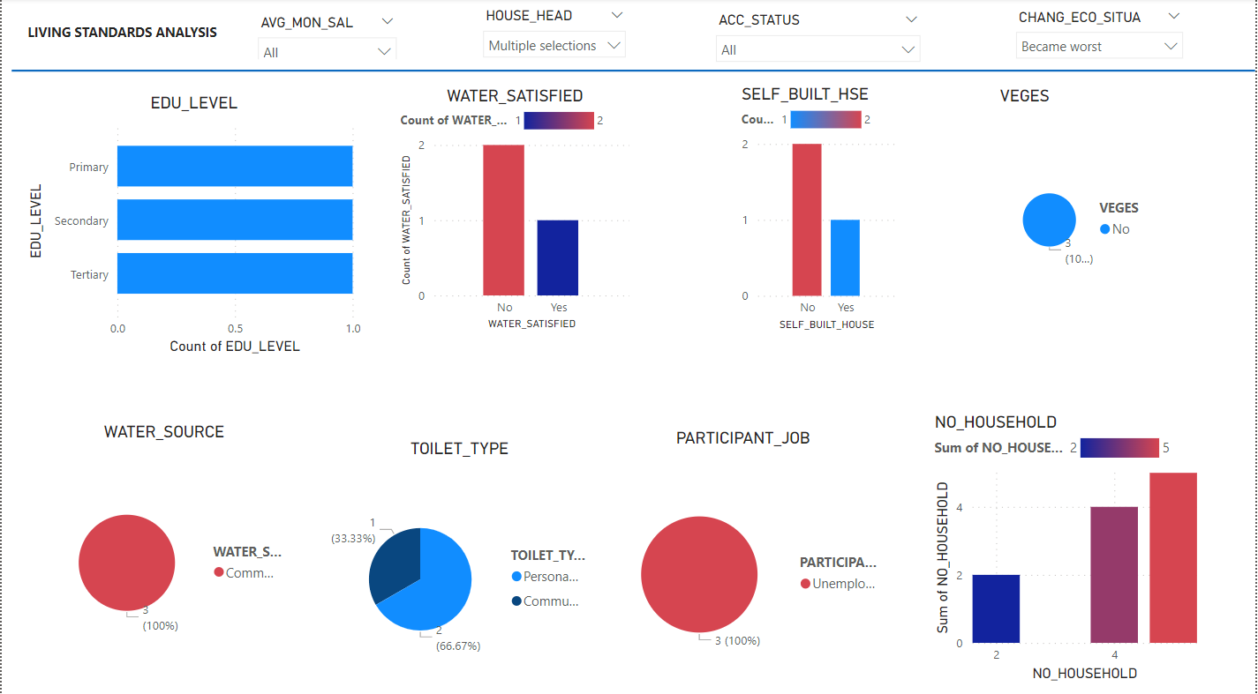
Change in economic situation in female headed houses : Became worst
Those who had their economic situation becoming worst were 4.8% of total female-headed houses.
These people had participants unemployed similar to men.
Majority of this household number was 5
They all had an average salary below 500 to 1500
They were not happy with water source

Slide 18
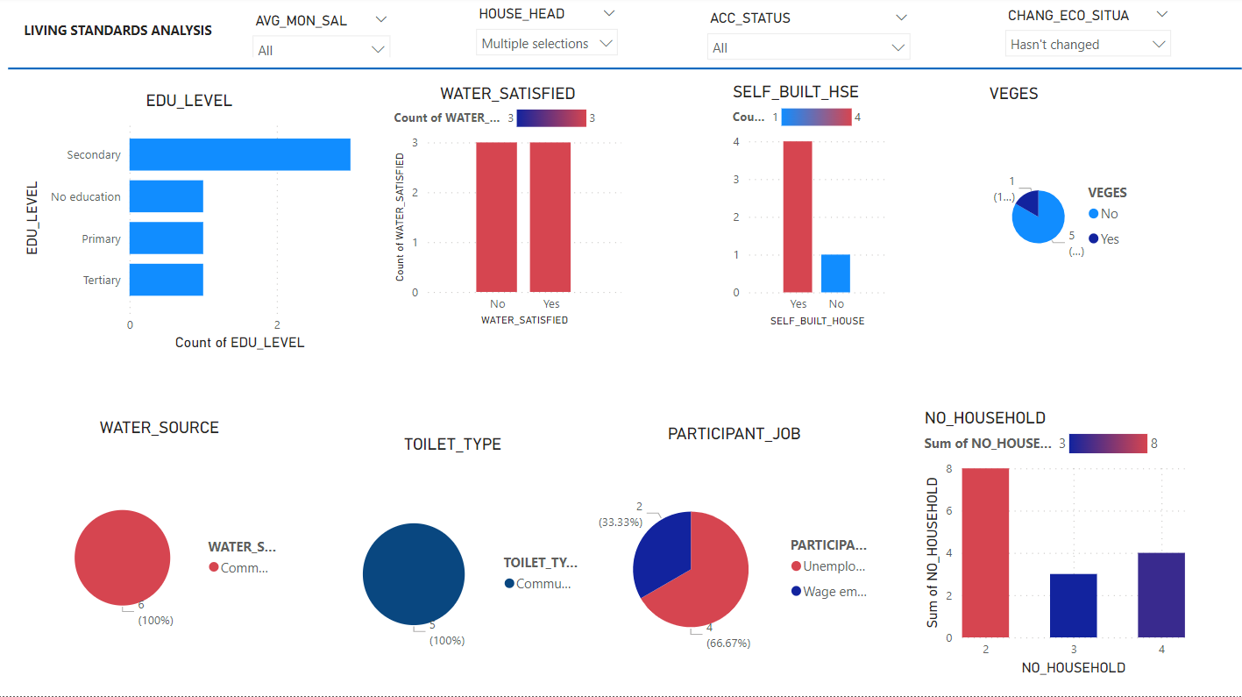
Change in the economic situation in female headed houses: No change in economic situation
those whose economic situation hasn’t changed
The average salary ranged from
Below 500 to 2000
They all used community resources for water and toilet and were indifferent about the water
67% of their participant were unemployed with a majority of 2 in a household

Slide 19
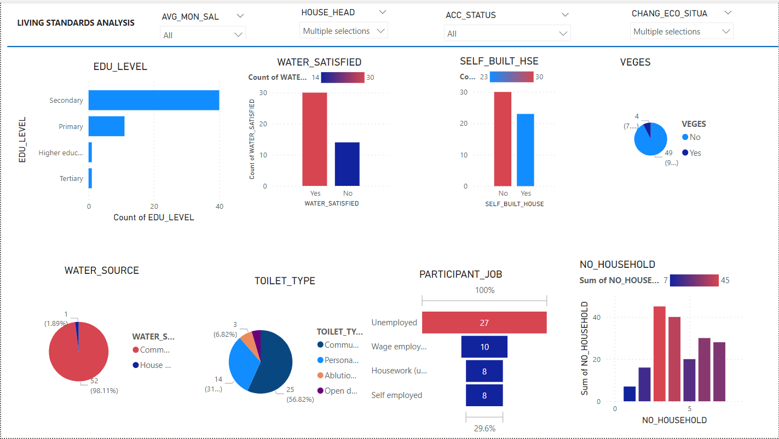
Change in the economic situation in female-headed houses: Improved a lot & Improved a bit
84% of the female headed house hold had some form of life improvement
The salary range didn’t say much about this improvement as people who even had low salaries had some form of improvement.
The majority were satisfied with their water source
Both had 3 as the dominant number of household

Slide 20
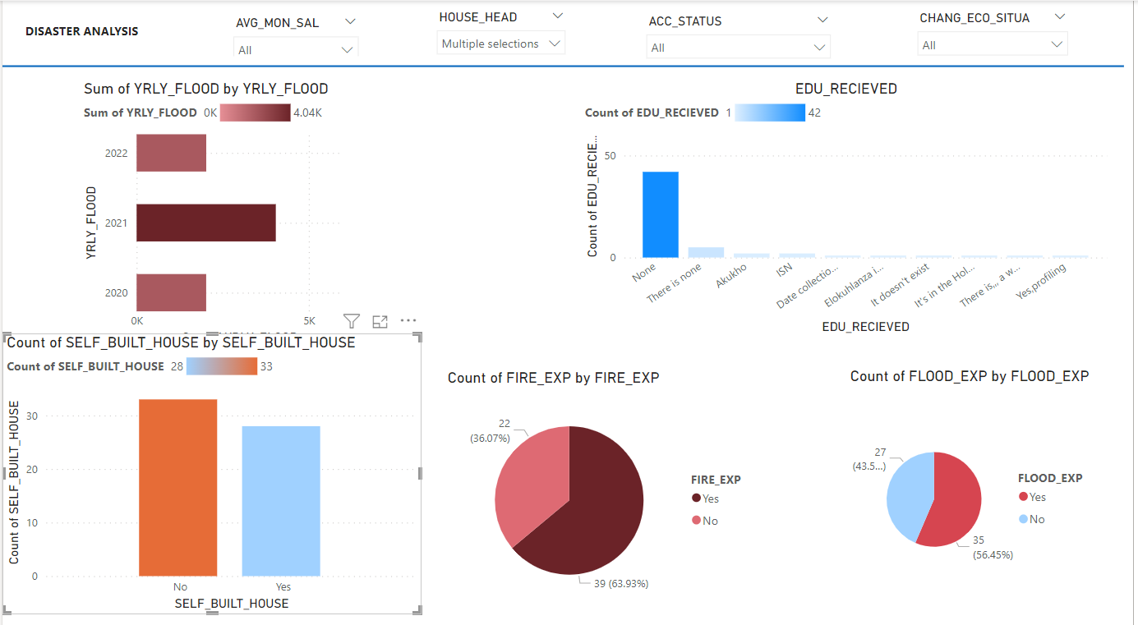
Disaster Analysis: Female Headed household
For female-headed houses the maximum number of floods that occurred in 2021 like men
64% had experienced fire
56% had experienced flood
But a majority didn’t build themselves?
Possibly this could be due to the fact that the majority hadn’t received social education as in the case of men
those who had the worst economic situation had 100% of fire experience like in men and 67% of flood experience
Those who rented in women-headed had 100% flood experience

Slide 21
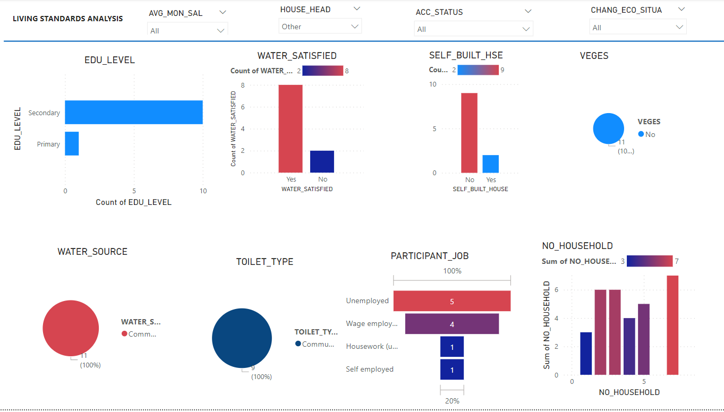
Living Standard dashboard of household headed by Others
Those who answered household head as others had basically either secondary or primary education
They all used community water and toilet and was mostly satisfied with their water source
House participant was mostly unemployed and the total number of household that dominated is 7
Their salary span from below 500 to 3500

Slide 22
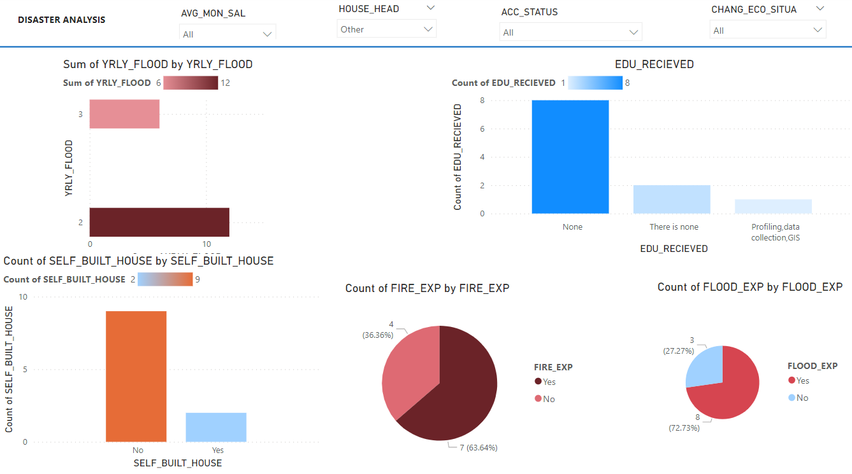
Disaster Analysis: Other Headed household
For female-headed houses the maximum number of floods that occurred in 2021 like men
63% had experienced fire
73% had experienced flood
But a majority didn’t build themselves?
Possibly this could be due to the fact that the majority hadn’t received social education as in the case of men

Slide 23
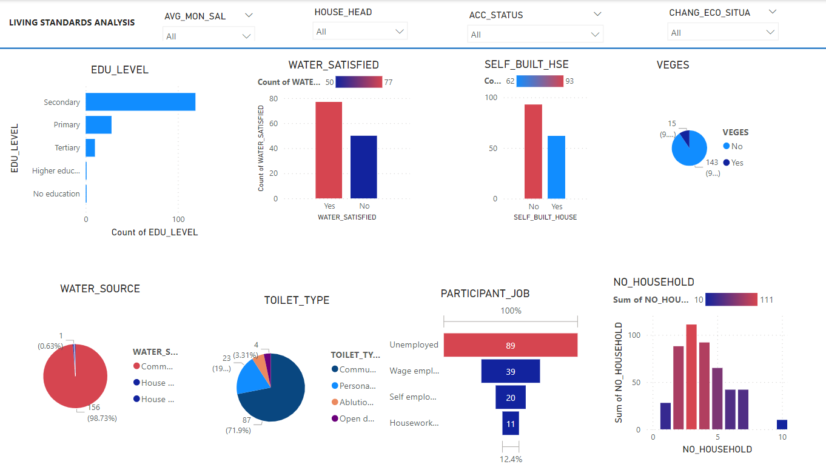
Living Standard dashboard: all inclusive
In total educational level was high among secondary education
98% of people used community water sources and were satisfied
56 of the participants of households were unemployed
The majority of households were 3 in number
All who said their living situation was worse were not satisfied with the water source, their average salary ranged from below 500 to 1500, participant of the household was all unemployed with a majority of 10 in a household in the number
Slightly different from those with an economic situation not changing was that their number in a household was mostly 2 and they were unsatisfied with their water source which was a community tap. their salary ranged from below 500 to 4000
For those with some improvement, they were satisfied with the water, a majority didn’t build themselves and the majority were 3 in a household

Slide 24
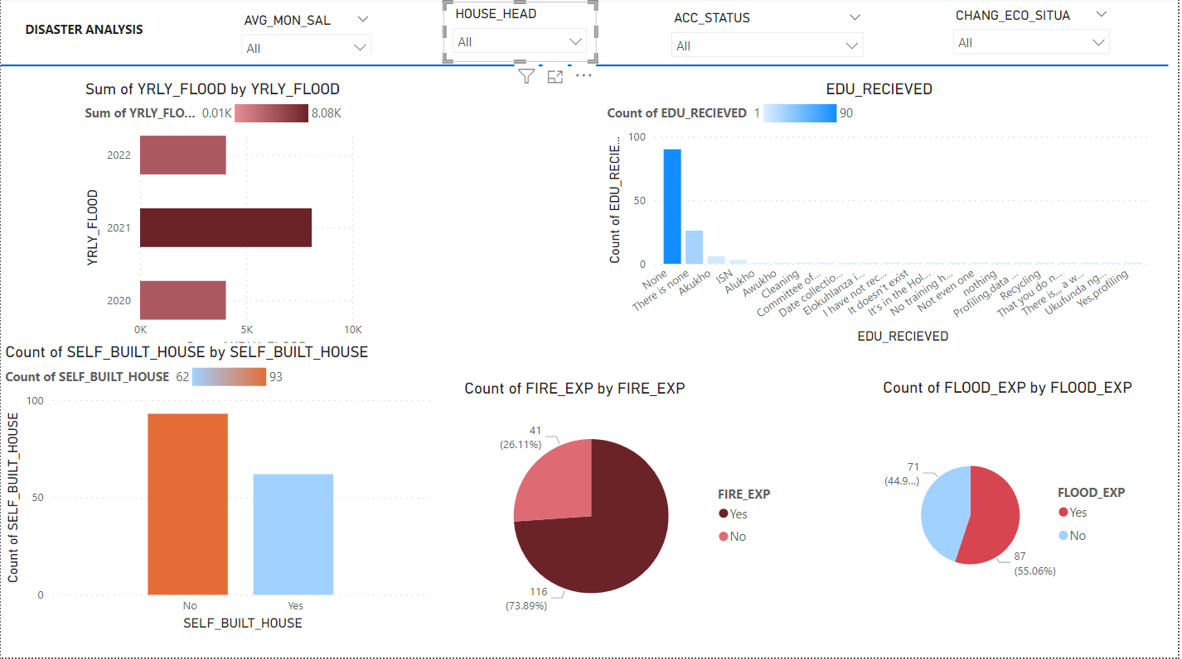
Disaster Analysis: ALL
Overall 2021 had more yearly floods
73% had experienced fire greater than 55% in term of flood
But a majority didn’t build themselves? 60%
Possibly this could be due to the fact that the majority hadn’t received social education overall

